Slide 1
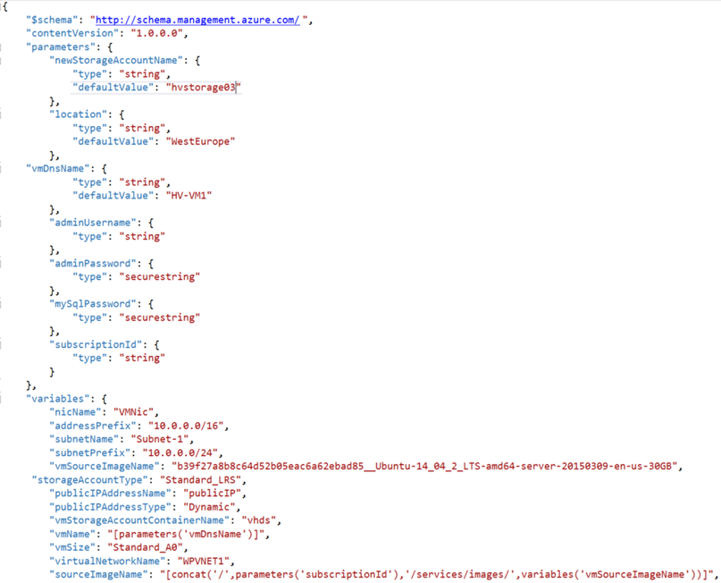



Infra-as-Code Hackathon
Infrastructure as Code
ARM & DSC…
July 9th-10th, 2018
Peter Laudati
Cloud Solution Architect
peterlau@Microsoft.com

Slide 2
Kick Off Agenda
Welcome & Intros
How all of this will work
Kick off & squad formation
Infrastructure as Code overview
Hands on Challenges & team learning!
Notes:
Welcome to homeroom… where we take attendance and make all the announcements, say the pledge of allegiance, etc.

Slide 3

Infra-as-Code Hackathon
Welcome & Intros
Peter Laudati
Pete Rodriguez
SME – Azure IaaS
SME – Azure IaaS
Al Wolchesky
Ali Hussain
SME – Azure IaaS
SME – Azure IaaS

Slide 4
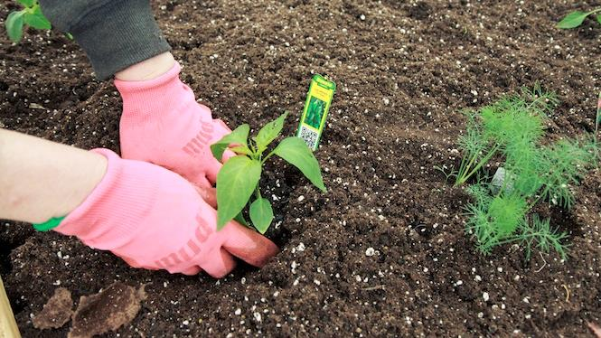
You will get your hands dirty

Slide 5
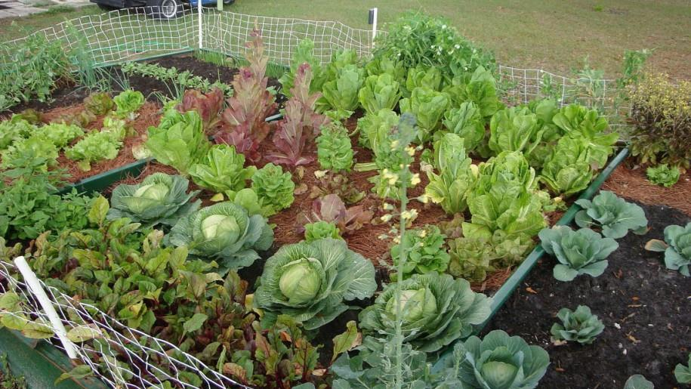
*results may vary
Notes:
You might not grow a garden like this… but at least you can learn while trying.

Slide 6


Slide 7

Logistics

Slide 8
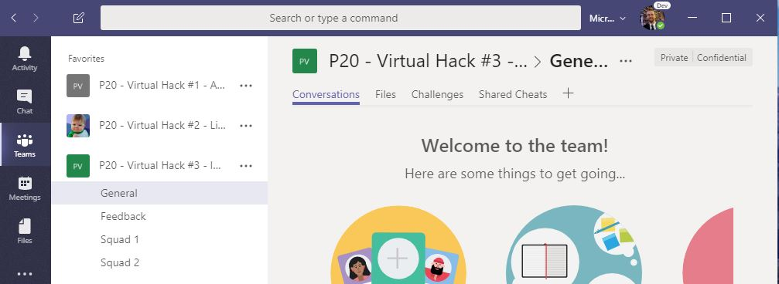
Using MS Teams
The kickoff, tech overviews, stand-ups, and wrap up will take place in the General channel
Hang out, communicate, talk, and screenshare with squad members in your squad’s channel
DURING & after the event, share feedback with the proctors in the Feedback channel. This will help them improve the event as it progresses and make the next one even better
Find any files, resources, or code samples, and THIS presentation here!
Challenges will be posted here by the proctors throughout the event
Share tips, tricks, gotchas (how you solved them), code snippets, and links you learn along the way here with everyone

Slide 9

Logistics Food

Slide 10
Agenda – Days 1 & 1
PowerPoint Overview
Iterative hands on challenges
Breaks for food and stretching
More team challenges
Sharing & recaps throughout the day

Slide 11
Challenge #0 Step 1: Get your machines ready!
Install Windows Subsystem for Linux (Bash Shell)
Install the Azure CLI (V2)
Install PowerShell Cmdlets for Azure
Install Visual Studio Code
Install ARM Template plugins for VS Code
ARM Tools
ARM Snippets
Install Azure Storage Explorer
Notes:
If you have a Mac… great! You’re already a step ahead.
If not, get your Windows box loaded up with all the tools that work well in the OSS world!

Slide 12

And now death by Power Point… (for an hour or so)

Slide 13
Infrastructure as Code

Slide 14
Infrastructure as Code
It’s critical to succeeding in the cloud!

Slide 15








Infrastructure as Code Three major parts
Deploying infrastructure
All of the stuff outside the VM
Vnets, VMs, load balancers, storage, etc
Configuration Management
Configuring all of the stuff inside the VM
Security, services, software, etc.
Orchestration
Stringing it all together with automation
ARM Templates
PowerShell
DSC
Notes:
If you have a Mac… great! You’re already a step ahead.
If not, get your Windows box loaded up with all the tools that work well in the OSS world!

Slide 16

3rd Party
Infrastructure
Deployment (Orchestration)
Terraform
A popular Infrastructure as Code tool as it has support for Azure, AWS, GCP, OpenStack and bare metal, providing customers with a single provisioning language across providers
Provider modules allow for provider specific features, so no “lowest common denominator” flaws of similar multi-cloud tools
“Planning” provides users a preview of changes prior to execution (Terraform plan)
https://docs.microsoft.com/en-us/azure/virtual-machines/terraform-create-complete-vm
https://www.terraform.io/docs/providers/azurerm/
Packer
An automated image builder capable of building containers, but primarily used for automating VM image builds
A great tool when combined with DevOps pipelines that are targeting deployment to services like Azure VMs, VM Scale Sets or Batch
Used internally to deliver VM images for HD Insights and Azure Container Service
https://aka.ms/azpacker

Slide 17


3rd Party
Configuration Management & Orchestration
Ansible
Configuration Management & Orchestration
Agentless architecture over SSH / WinRM
Benefit of more easily integrating existing environments
YAML based “Playbooks” to define automation tasks as code
Project now run by Red Hat
https://docs.microsoft.com/en-us/azure/virtual-machines/linux/ansible-create-complete-vm
https://docs.ansible.com/ansible/guide_azure.html
Chef Server
Configuration Management
Integrates in to Chef’s Automate offering, available in Azure Marketplace
YAML/JSON based “Cookbooks” to define automation tasks as code
Agent based, requires an agent installed on managed servers.
https://www.chef.io/implementations/azure/
Notes:
Compare/Contrast: (Orchestration vs Configuration Management tools) Configuration management tools such as Chef and Ansible,typically default to a mutable infrastructure paradigm. For example, if you tell Chef to install a new version of OpenSSL, it’ll run the update on your existing servers and the changes will happen in-place. Over time, as you apply more and more updates, each server builds up a unique history of changes. This often can lead to configuration drift, where each server becomes slightly different than all the others, leading to subtle configuration bugs that are difficult to diagnose/reproduce. If you’re using an orchestration tool such as Terraform to deploy machine images created by Docker or Packer, then every “change” is actually a deployment of a new server, you would create a new image using Packer or Docker with the new version of OpenSSL already installed, deploy that image across a set of totally new servers, and then de-provision the old servers. This approach reduces the likelihood of configuration drift bugs. Of course, it’s possible to force configuration management tools to do immutable deployments too, but it’s not the idiomatic approach for those tools, whereas it’s a natural way to use orchestration tools.
Chef and Ansible encourage a procedural style where you write code that specifies, step-by-step, how to to achieve some desired end state. Terraform, CloudFormation, SaltStack, and Puppet all encourage a more declarative style where you write code that specifies your desired end state

Slide 18


OrchestrationTools
Jenkins
Most popular Continuous Integration & Continuous Delivery Tool
Especially popular with Java shops
An extensive community and catalog of plugins available
Azure Plugins available to use on-demand VMs for Build & Test
Jenkins Solution Template: https://aka.ms/jenkins-on-azure
Microsoft published. A Jenkins build secured for Azure and pre-configured with Azure plugins and tools
Jenkins Hub is a great starting point for customers: http://aka.ms/azjenkinshub
Spinnaker
Continuous Deployment Tool
Originally open sourced by NetFlix
Provides the ability to manage continuous deployment pipelines with multiple deployment strategies and the ability to roll back easily to previous versions
Spinnaker Code Labs for Azure:
CD to Azure VM ScaleSet
CD to K8s on Azure

Slide 19

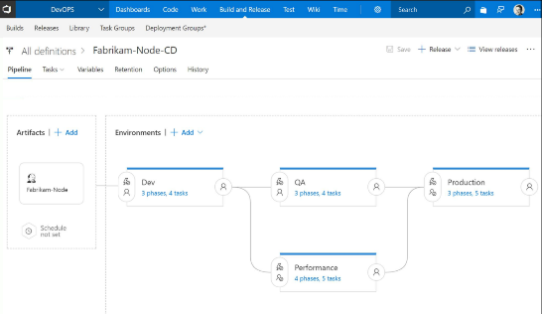
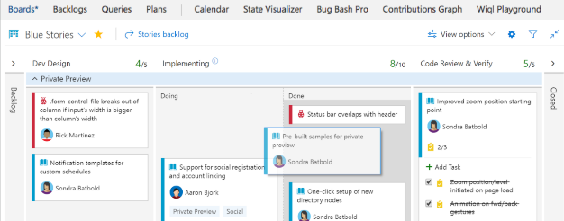
CI/CD Tools
Visual Studio Team Services
Microsoft’s Continuous Integration & Continuous Delivery Tool
Test and deploy your code to production with high-performance pipelines. Start small and scale up as needed.
VSTS has everything you love about Git with free private repositories, pull requests, and code review.
Collaborate with coworkers then integrate with CI/CD to get your code to production fast.
VSTS gives you configurable Kanban boards, interactive backlogs, simple planning tools, and out-of-the-box support for Scrum-all integrated together for traceability and reporting.
Code once and share packages across your organization. Host your private Nuget, npm, and Maven packages with VSTS for more reliable, scalable builds.
Use VSTS to setup test plans and track and report manual tests, run automated test suites, and run cloud-based load tests.

Slide 20
Azure Resource Manager Overview

Slide 21



Azure structure
Account and enterprise agreement
Subscription(s)
Resource group
Resource group
SQL
SQL
Role-based access control
Tags
Azure Resource Manager policy
Templates
Notes:
Presentation notes:
Key concepts:
Resource groups: application lifecycle boundary; container that holds resources.
Resources: web apps, Azure SQL Database, storage account, network, and so on…almost everything.
RBAC (role-based access control): User groups with role permissions assigned to resource groups.
Tags: Key value pairs assigned to resources or resource groups.
Policy: Restrictions on resources; for example, we can enforce mandatory tags per resource type.
Templates: JSON (JavaScript Object Notation) defining deployment and configuration of your application.
Slide objective:
Explain the hierarchy of the Azure model and key concepts.
Speaker notes:
When we talk about how we’ve done our Azure structure, we think about subscriptions. You want to lay out your subscriptions based on technology, the type of policy that you want to apply, and how your business is laid out. We use RBAC, which is role-based access control, to ensure that the right people have the right access to the right subscriptions. We want to make sure that people can operate their business, information remains protected, and people can’t make changes when they’re not supposed to.
The lower level is the concept of the resource group, an Azure construct that allows you to put the various resources associated with a single app into a resource group and then apply policy from Azure Resource Manager and tags. We use tags—key-value pairs—in Microsoft IT to identify the organization that it’s related to, the environment, and the app ID, a unique identifier. We can use these tags to associate different resources to a different app, organization, or environment, and then make business decisions based on that. Resources include web apps, Azure SQL Database, storage account, and so on.
Templates: We’ve created specific templates that internal teams can use to build out resources, and we ensure that they build them out according to our standards and policies. Templates enforce the creation of tags for tracking.

Slide 22
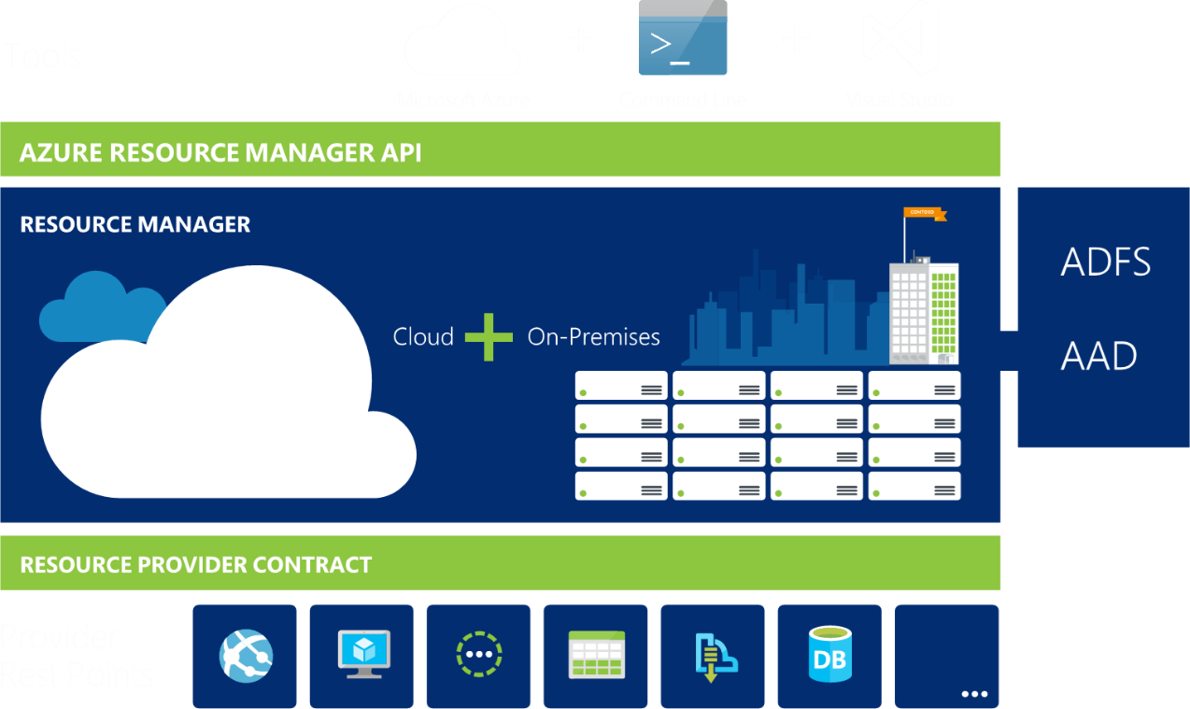
Azure Resource Manager
Azure Resource Manager or ARM management interface for Azure
Notes:
ARM is the underlying tooling that allows for the provisioning, securing and deployment of Azure Resources.

Slide 23
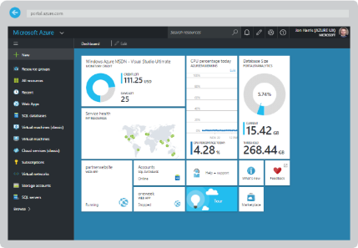
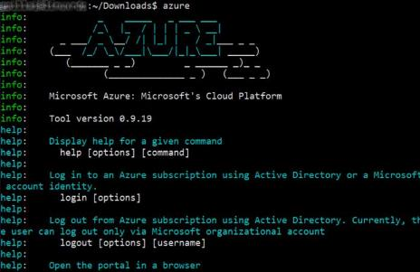
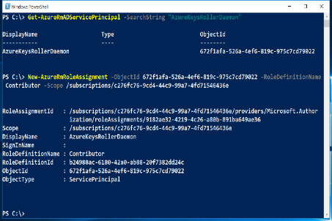

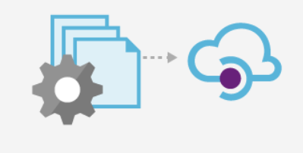
Azure Portal
Azure CLI
Azure PowerShell
Azure Resource Manager
Tenant
Tenant
Azure API
Subscription
Subscription
Subscription
Resource Group
Resource Group
Resource Group
Resource Group

Slide 24
Resource Providers
Web Site
Storage
Individual resources
Provision resources in isolation
Deployment becomes more complex
Management of app is challenging
Proper use of resources becomes more abstract
Isolation makes communication a challenge
Database
Virtual Machine

Slide 25
Resource Groups
Logical groups of multiple resources of similar or different types
Every resource must be in a resource group, cannot be in more than one
Resources inside resource group may span across regions
Resource Group has a location for storing metadata
RESOU
R
CE G
R
OUP

Slide 26
Resource Group Lifecycle
Question:
Should these resources be in the same group or a different one?
Hint:
Do they have common lifecycle and management?
Answer:
Up to you.

Slide 27
Organizational concepts
Resource groups
Tightly coupled to a container of resources
Follows RBAC rules
1 resource group at a time
Tags
Loosely coupled user or system defined categorization
Arbitrary boundaries
15 tags to use as needed
Resource groups and tags are the building blocks from which users define applications.

Slide 28
Access Control: RBAC
Allows secure access with granular permissions to resources
Assignable to users, groups or service principals or VMs
Built-in roles make it easy to get started

Slide 29
Scripting vs Declarative
PowerShell or Azure CLI
Sequential code calling commands to create the infrastructure.
ARM Templates
A JavaScript Object Notation (JSON) file that defines one or more resources to deploy to a resource group. It also defines the dependencies between the deployed resources. The template can be used to deploy the resources consistently and repeatedly.
declarative syntax - Syntax that lets you state "Here is what I intend to create" without having to write the sequence of programming commands to create it. The ARM template is an example of declarative syntax.

Slide 30
Let’s get a look at the template…

Slide 31
The template
Structure and elements
{
"$schema": "http://schema.management.azure.com/schemas/2015-01-01/deploymentTemplate.json#",
"contentVersion": "",
"parameters": { },
"variables": { },
"resources": [ ],
"outputs": { }
}
Declarative syntax
Allows you to declare the resources you want to have without having to write the script sequence of commands required to create it.

Slide 32
The template - Parameters
Minimize parameters
Too many parameters may confuse the user
Use the “metadata” to describe the parameter
This can help the user identify how and where the value will be used
Define default values
Setting default values guides user and reduces chances of invalid values
Parameters are mandatory, use default value to “make it optional”
Use securestring type
Passwords and secrets should use the securestring type

Slide 33
The template - Parameters

Slide 34
The template - Variables
Easier to read and edit
It can simplify your template, making it easier to read
Complex objects
Group variables into an object helps understand the template design
Custom values
Use expressions and functions to modify parameter values and construct new values

Slide 35
The template - Variables
"variables": {
"storageAccountName": "[concat(uniquestring(resourceGroup().id), 'sawinvm')]",
"nicName": "myVMNic",
"subnetRef": "[resourceId('Microsoft.Network/virtualNetworks/subnets', parameters('virtualNetworkName'), parameters('subnetName'))]",
"environmentSettings": {
"test": {
"instancesSize": "Small",
"instancesCount": 1
},
"prod": {
"instancesSize": "Large",
"instancesCount": 4
}
}
}

Slide 36
The template - Resources
Use “comments”
Use this tag to help others understand the purpose of the resource
ApiVersion
This property value will define the structure of the “properties” section of the resource
Hard-code it on the resource, so Visual Studio Intellisense can recognize it
Protected Settings
Use this property to pass secrets if the resource type supports it

Slide 37
The template - Resources
{ "type": "Microsoft.Storage/storageAccounts",
"name": "[variables('storageAccountName')]",
"apiVersion": "2016-01-01",
"location": "[resourceGroup().location]",
"sku": {
"name": "Standard_LRS"
},
"kind": "BlobStorage",
"properties": { "accessTier": "Hot" }
},
{ "type": "Microsoft.Storage/storageAccounts",
"name": "[parameters('storageAccountName')]",
"apiVersion": "2015-06-15",
"location": "[resourceGroup().location]",
"properties": {
"accountType": "Standard_LRS"
}
}

Slide 38
Deploying the template
Powershell
New-AzureRmResourceGroupDeployment -Name ExampleDeployment -ResourceGroupName ExampleResourceGroup -TemplateFile <PathToTemplate> -
Azure CLI
azure group deployment create -f "c:\MyTemplates\example.json" -g examplegroup
-n exampledeployment
REST API
PUT /subscriptions/{subscriptionId}/resourcegroups/{resourceGroupName}/providers/Microsoft.Resources/deployments/{deploymentName}?api-version=2016-09-01
az group deployment create -f "c:\MyTemplates\example.json" -g examplegroup
-n exampledeployment

Slide 39
Template Tools ( http://aka.ms/azuretools )
Visual Studio
Visual Studio Code
PowerShell / CLI
VSTS
https://docs.microsoft.com/en-us/azure/azure-resource-manager/resource-group-template-functions
https://docs.microsoft.com/en-us/azure/templates/

Slide 40
Challenge #1 Step 2: Create a “Hello World” template
Create a template that:
Takes one input parameter
Returns one output value
Deploy it from PowerShell
Deploy it from Azure CLI

Slide 41
ARM Templates: Recap
Create a blank template with your favorite text editor
Complete walk-through : https://docs.microsoft.com/en-us/azure/azure-resource-manager/resource-group-authoring-templates
{
"$schema": "http://schema.management.azure.com/schemas/2015-01-01/deploymentTemplate.json#",
"contentVersion": "",
"parameters": { },
"variables": { },
"resources": [ ],
"outputs": { }
}
Strip away the details and the template core is seen above

Slide 42
Debugging…
Code Editors
Resource Explorer
Deployment output
Resource Group Deployments
Activity Logs
VM Extension Logs

Slide 43
Creating a template How to fish for template syntax…
Visual Studio code
ARM snippets plugin can inject template syntax for various Azure resources
Go to the docs! https://docs.microsoft.com/en-us/azure/templates/
Export Template from portal before resource creation
Template will be parameterized for single resource
Quickstart templates
https://github.com/Azure/azure-quickstart-templates
Export Template from portal of existing Resource Group
To duplicate or slightly modify an existing template

Slide 44
Challenge #2 Deploy a simple network stack
Extend template to provision VNET w/one subnet
Template takes the following inputs:
Virtual Network Name and Address Prefix
Subnet Name and Address Prefix
Find an easier way to pass in parameters

Slide 45
Practices to avoid. . . ( !best practices )
Starting from scratch. . .
Leverage QuickStarts, Automation Script / Export, etc. to quickly get started
Over-parameterization (no defaultValues)
Use variables, functions/expressions, & intelligent defaults!
Duplicating code
Copy/Pasting and Nesting instead of using copy loops & functions/expressions
Variables for the sake of variables
“vmName” : “[parameters(‘vmName’)]”
Secrets in source
Use KeyVault and Managed Identity
Variables for api-version
New api-version represents an updated payload
Using the wrong template expression, wrong function or wrong approach (mul)
E.g. use resourceId() instead of concat()
Not using a template expression or wrong function
Unnecessary dependencies
Use dependsOn and/or reference() only when necessary
Hard-coding
URIs, Ips, secrets, locations, VM sizes, etc
RunOnce behaviors
Build idempotent, re-entrant templates
Thinking imperatively
ARM templates describe the goal state of an application, and the sequence in which that state can be realized
https://github.com/Azure/azure-quickstart-templates
Notes:
NSG – Secure the app
User Choice – when it makes sense (location, SKU)
Use reference for endpoints

Slide 46
Azure Resource Manager Terminology
resource - A manageable item that is available through Azure (e.g. virtual machine, storage account, web app, database, virtual network etc)
resource group - A container that holds related resources for an Azure solution. The resource group can include all the resources for the solution, or only those resources that you want to manage as a group.
resource provider - A service that supplies the resources you can deploy and manage through Resource Manager. Each resource provider offers operations for working with the resources that are deployed. For example Microsoft.Compute is a provider that supplies the virtual machine resource.
Resource Manager template - A JavaScript Object Notation (JSON) file that defines one or more resources to deploy to a resource group. It also defines the dependencies between the deployed resources. The template can be used to deploy the resources consistently and repeatedly.
declarative syntax - Syntax that lets you state "Here is what I intend to create" without having to write the sequence of programming commands to create it. The Resource Manager template is an example of declarative syntax.

Slide 47
Tour of Advanced Functions
Array and Objects
Concat()
Comparison
”Condition” field on a resource using equals()
Deployment
Linking
Numeric
copyIndex() used for looping
Resource
resourceGroup().location and .tags (array of tags)
String
toLower()
uniqueString(context), talks about context of uniqueness (resourceGroup, Subscription, etc)
https://docs.microsoft.com/en-us/azure/azure-resource-manager/resource-group-template-functions-array

Slide 48
ARM Advanced Feature: concat()

Slide 49
Concat()…array and object function
Combines multiple arrays and returns the concatenated array, or combines multiple string values and returns the concatenated string
Concatenating multiple strings to create unique and dynamic names (in my opinion) is the most common and useful
“variables”: {
“vnetName”: “[concat(parameters(‘prefix’),’-VNET’)]”
…
}
https://docs.microsoft.com/en-us/azure/azure-resource-manager/resource-group-template-functions-array#concat

Slide 50
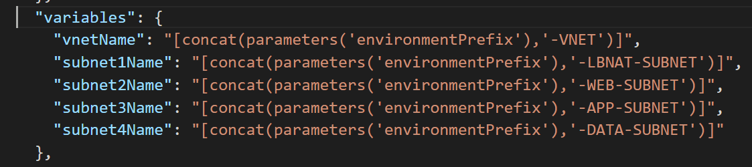
Snippet: concat() in action

Slide 51
ARM Advanced Feature: condition and equals()

Slide 52
Condition()…comparison functions
Allows you to compare two values with functions such as equals, less, lessOrEquals, greater, greaterOrEquals
Combine “equals” with the “condition” element to test whether a resource is deployed (most useful example of comparison functions that I’ve found yet)
{
“condition”: “[equals(variables(‘newOrExisting’),’new’]”
…
}
https://docs.microsoft.com/en-us/azure/azure-resource-manager/resource-group-template-functions-comparison

Slide 53
Condition in Action
Run nb-conditional-deploy-v1.json and create a storage account
Check the portal and confirm the existence of the new storage account
Run nb-conditional-deploy-v2.json and create a second storage account with the conditional variable set to existing
Check the portal and confirm the new storage account was NOT created
Run nb-conditional-deploy-v2.json and create a second storage account with the conditional variable set to ‘new’
Check the portal and confirm the new storage account WAS created
[link to both templates needed]

Slide 54
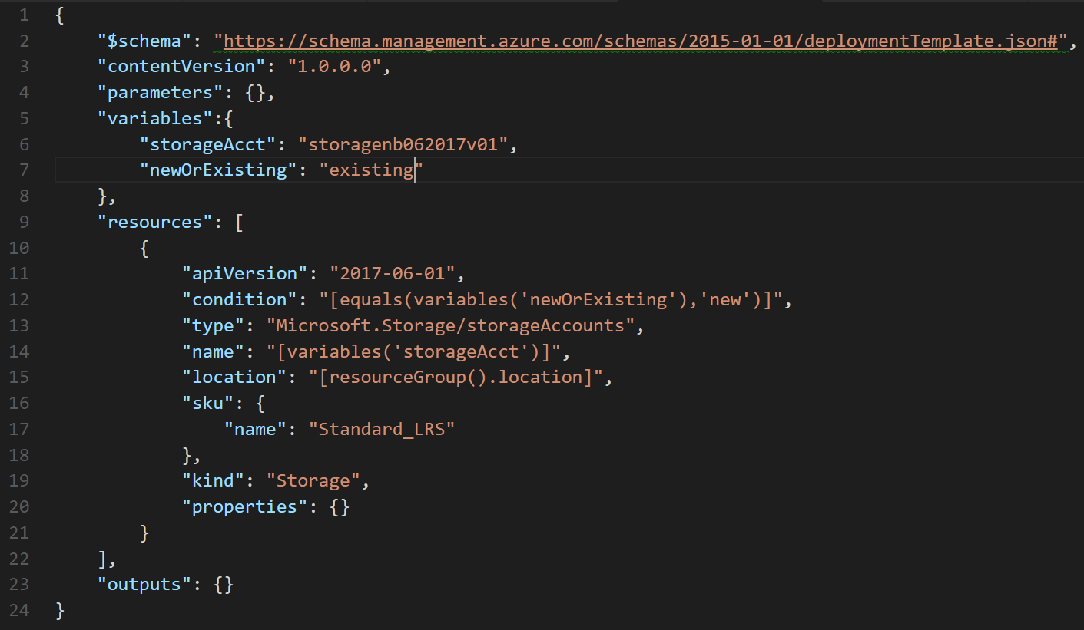

Slide 55
ARM Advanced Feature: copyIndex() aka Looping

Slide 56
copyIndex()…numeric function
Add a “copy” section to a resource and reference with the copyIndex() function
"resources": [
{
"apiVersion": "2016-01-01",
"type": "Microsoft.Storage/storageAccounts",
"name": "[concat(copyIndex(),'storage', uniqueString(resourceGroup().id))]",
"location": "[resourceGroup().location]",
"sku": {
"name": "Standard_LRS"
},
"kind": "Storage",
"properties": {},
"copy": {
"name": "storagecopy",
"count": 3
}
}
https://docs.microsoft.com/en-us/azure/azure-resource-manager/resource-group-create-multiple

Slide 57
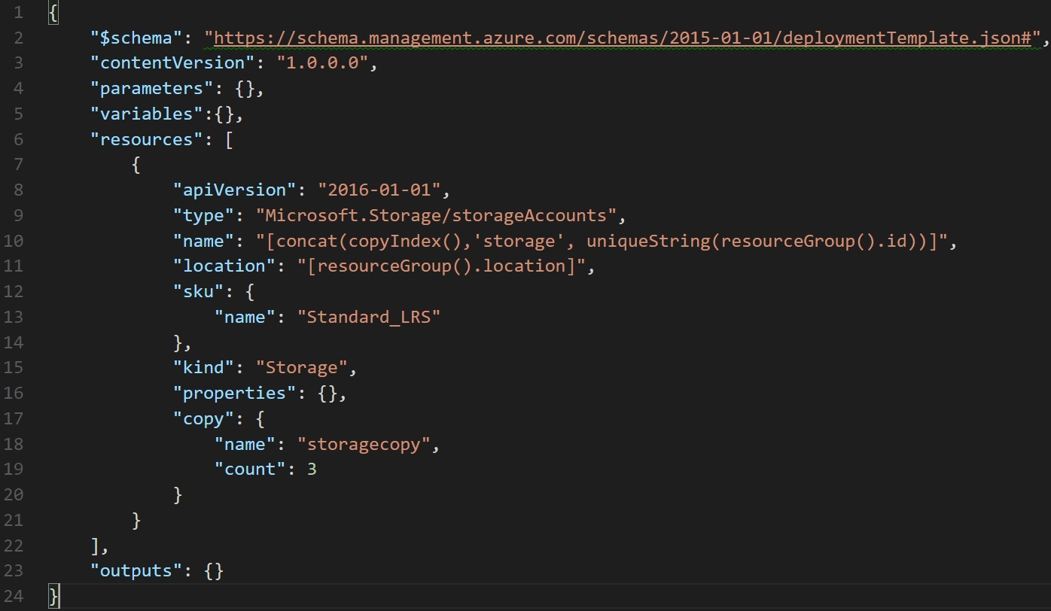

Slide 58
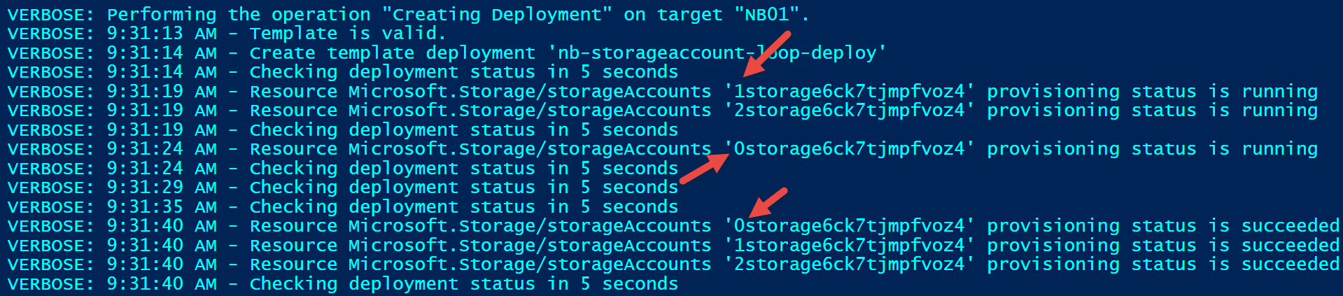
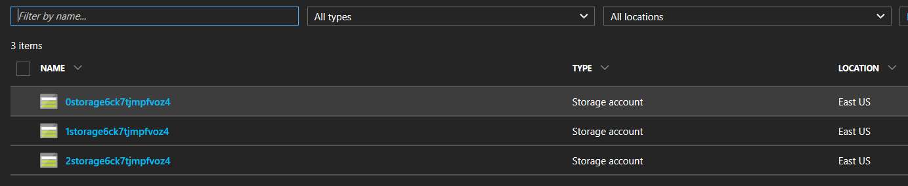
Verbose output

Slide 59
Can I create more meaningful names?
Tried:
"name": "[concat('storage-0', copyIndex(1))]", (did it work?)
Got error:
New-AzureRmResourceGroupDeployment : 9:51:45 AM - Error: Code=AccountNameInvalid; Message=storage-01 is not a valid storage account name. Storage account name must be between 3 and 24 characters in length and use numbers and lower-case letters only.
Tried:
"name": "[concat('storage0', copyIndex(1))]", (did it work?)
Got error:
New-AzureRmResourceGroupDeployment : 9:52:45 AM - Error: Code=StorageAccountAlreadyTaken; Message=The storage account named storage01 is already taken.

Slide 60
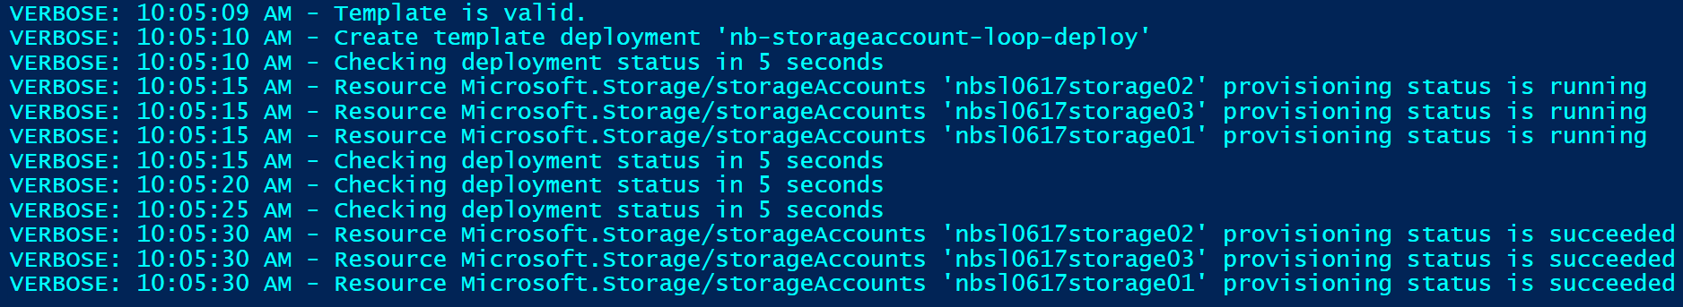
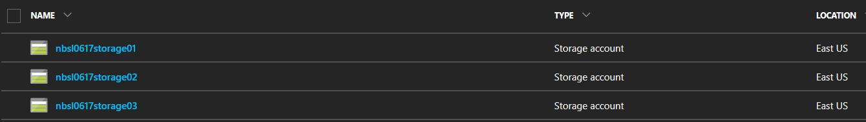
Got it working…finally
Tried:
"name": "[concat(parameters('environmentPrefix'),'storage0', copyIndex(1))]"

Slide 61
Final thoughts on looping with copyIndex()
You can iteratively create multiple resources of the same type
Resources are created in parallel unless the mode is set to “serial” (default is parallel…should it specified?)
You can iterate on a resource property also
Code snippets from documentation are difficult to get working. Never could get the Vnet and Subnet sample to work.
Comments on documentation page express clear frustration using copyIndex. Your mileage may vary.

Slide 62
ARM Advanced Feature: toLower()

Slide 63
toLower()…string function
Useful collection string manipulation functions
How useful depends on your needs and approach to ARM templates
toLower() useful to help ensure proper formatting
"variables":{
"prefix": "NBTL062017"
},
…
"name": "[concat('storagev', toLower(variables('prefix'))]",
https://docs.microsoft.com/en-us/azure/azure-resource-manager/resource-group-template-functions-string

Slide 64
Error without toLower()
Run nb-tolower-deploy.json with and without toLower (example error message without toLower below)
"error": {
"code": "AccountNameInvalid",
"message": "storev22NBTL062017 is not a valid storage account name. Storage account name must be between 3 and 24 characters in length and use numbers and lower-case letters only."
}

Slide 65
Advanced Functions: Food for thought
Some functions are easy to integrate into your templates (concat)
Some functions require some trial-and-error to get them to do what you expect (copyIndex)
Obviously some functions are more useful than others and some are simply not worth the effort
The real question is…how much intelligence do you want to insert into your templates?
It might make more sense to use Powershell or CLI as the “glue” that holds the template(s) together and contains the “real” intelligence
The bigger the template, the harder to maintain

Slide 66
ARM Advanced Feature: resourceId

Slide 67
ResourceID property
Unique identifier of a resource in Azure
Used to reference one resource as a parameter in another resource.
Example: A virtual machine needs to specify the resourceID of the NIC that it is attached to
Example: A NIC needs to specify the resourceID of the vnet+subnet that it is attached to. (Often, the Vnet will be deployed in a separate resource group!)
Example: A Vnet can specify the resourceID of a NSG that is applied to it.
A fully qualified ResourceID is a concatenation of:
<subscriptionID>/<resourceGroupName>/<resourceType>/<resourceName>
Example: “acc9711d-c67e-47b0-bba3-9f6561a68511/myResourceGroup/Microsoft.Network/networkSecurityGroups/myNSG”
ResourceID can be inferred from name & type if it’s unique within scope
Example: “<resourceType>/<resourceName>”
“Microsoft.Network/networkSecurityGroups/myNSG”
This works as long as there’s a NSG called “myNSG” in the current resource group.
If I’m looking for “myNSG” in some other resource group or subscription, then this won’t work!

Slide 68
resourceId()…resource function
resourceId() is seen often in auto generated templates and some from the Git repo
Returns the unique identifier of a resource which is useful when the resource name is ambiguous or not provisioned with the same template
Often used to reference storage accounts or virtual networks in an alternate resource group
"variables": {
"vnetID": "[resourceId(parameters('virtualNetworkResourceGroup'), 'Microsoft.Network/virtualNetworks', parameters('virtualNetworkName'))]",
"subnet1Ref": "[concat(variables('vnetID'),'/subnets/', parameters('subnet1Name'))]"
}
https://docs.microsoft.com/en-us/azure/azure-resource-manager/resource-group-template-functions-resource

Slide 69
Hands-on: Create an ARM Template with Advanced Features

Slide 70
Challenge #3 Deploy more than one resource
Extend template to open ports 80 and 3389 on the default subnet
Hint: Consider variables, dependencies (resourceIDs), and idempotency

Slide 71
Challenge #4 (Windows) Let’s do something real…
Extend template to deploy a VM
VM Requirements:
Windows Server 2016 Datacenter
Public IP address (for dev/hack purposes only. Never in production! ☺)
Clean up parameters and variables - use resource prefix & variable name suffixes
Hint: Globally unique naming context, and complex dependencies! ☺

Slide 72
Challenge #4 (Linux) Let’s do something real…
Extend template to deploy a webserver VM
VM Requirements:
Linux VM (Ubuntu)
Apache website
Pull website config from: https://raw.githubusercontent.com/albertwo1978/training-events/master/p20-arm/scripts/install_apache.sh
Hint: Custom script extensions, globally unique naming context, and complex dependencies! ☺

Slide 73
ARM Advanced Feature: linked templates

Slide 74
Linked/Nested Templates
Useful for “separation of duties” (e.g. network team responsible for network templates, etc)
Linked templates cannot be local.
Linked templates must be ‘staged’ at an http endpoint for the Azure Resource Manager to access them.
Use a storage account or git repo for staging
You can pass parameters directly to the linked template as you would the parent template
{
"type": "Microsoft.Resources/deployments",
…
}
https://docs.microsoft.com/en-us/azure/azure-resource-manager/resource-group-template-functions-deployment

Slide 75
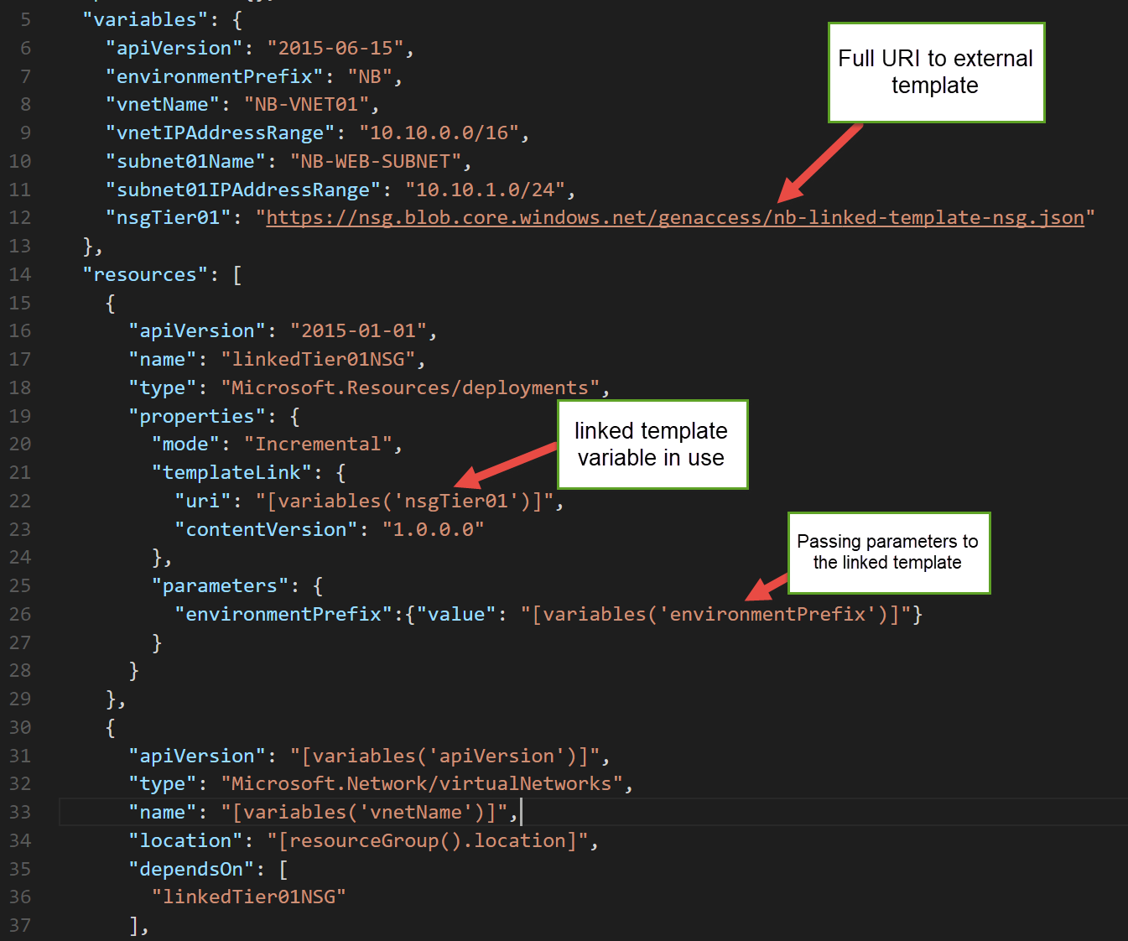
Example

Slide 76
What about linking to “private” templates?
We can do this with a SAS token!
Generate a SAS token on the container where your “private” template will be staged.
Pass the blob container URL & SAS token as parameters
Concatenate the container URL, template filename, and SAS token to construct the templateLink URI property
https://docs.microsoft.com/en-us/azure/azure-resource-manager/resource-group-linked-templates
https://docs.microsoft.com/en-us/azure/storage/storage-dotnet-shared-access-signature-part-1

Slide 77
Challenge #5 Break it up!
Pull out the VNet & NSG into their own template
Keep the VM (and it’s dependencies– NIC, PIP, etc) in its own template
Create a new “master” template that calls the Networking template, then the VM template

Slide 78
Desired State Configuration

Slide 79
Desired State Configuration (aka DSC) Demo here…
What is DSC?
How do you use it?
What are DSC Resources
Code snippet of DSC script

Slide 80
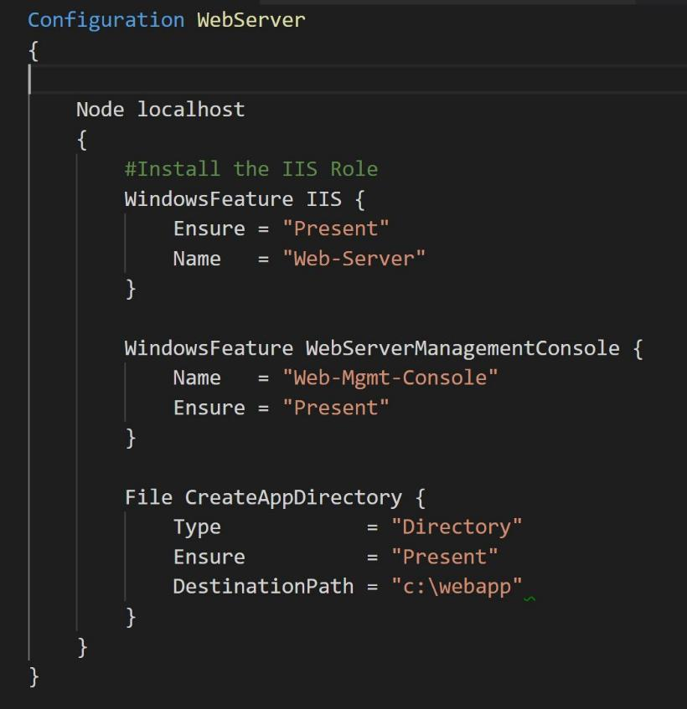
Desired State Configuration (aka DSC) Built in DSC Resources…
Archive Resource
Environment Resource
File Resource
Group Resource
Log Resource
Package Resource
Registry Resource
Script Resource
Service Resource
User Resource
WindowsFeature Resource
WindowsProcess Resource
Built in DSC Resources: https://docs.microsoft.com/en-us/powershell/dsc/builtinresource

Slide 81
Desired State Configuration (aka DSC) What goes where…
Package DSC script (script.ps1) into archive (script.ps1.zip)
Deploy archive file to staging (artifact location/blob storage)
Provide staging URI to ARM template’s DSC Extension resource

Slide 82
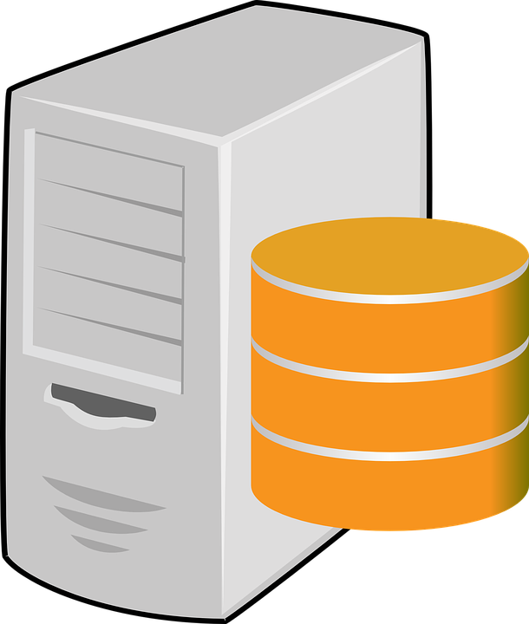
A File Server!!!

Slide 83
Challenge #6 Step 8: Hello World DSC
Add a DSC extension to the ARM Template
Add a DSC script to add 3 folders to the C drive
Ex: “Folder1”, “Folder2”, “Folder3”
Go through the motions of packaging the DSC script up and deploying via blob storage

Slide 84
Using DSC Resources How to fish for new ones…
Browse PowerShell Gallery
Browse PowerShell Github Repo
Browse Azure Quickstart Templates
Google it* with Bing! (*where ‘it’ is the task you want to configure with DSC)
Repeat!

Slide 85
Using DSC Resources Once you find the droid you’re looking for…
Read its docs & examples on its Github repo
Add a Import-Module –Name <DSCResourceName> statement
Use it in your DSC script! (.ps1 file)
Download/install the module locally on your workstation
Include the module’s files in the archive file
Deploy the archive file to the staging location
Hint: Use the Publish-AzureRmVMDscConfiguration cmdlet to package & stage the archive file directly to Blob Storage!

Slide 86
Challenge #7 Step 8: More complex DSC
Extend the DSC by creating SMB shares on each folder
Ex: \\Share1, \\Share2, \\Share3
Hint: Use a DSC Resource

Slide 87
Composite DSC Let’s refactor out some common code…
DSC configurations can get long and complex quickly.
You want to have custom DSC resources specifically for your infrastructure
Useful for splitting the management of desired state amongst different teams.

Slide 88
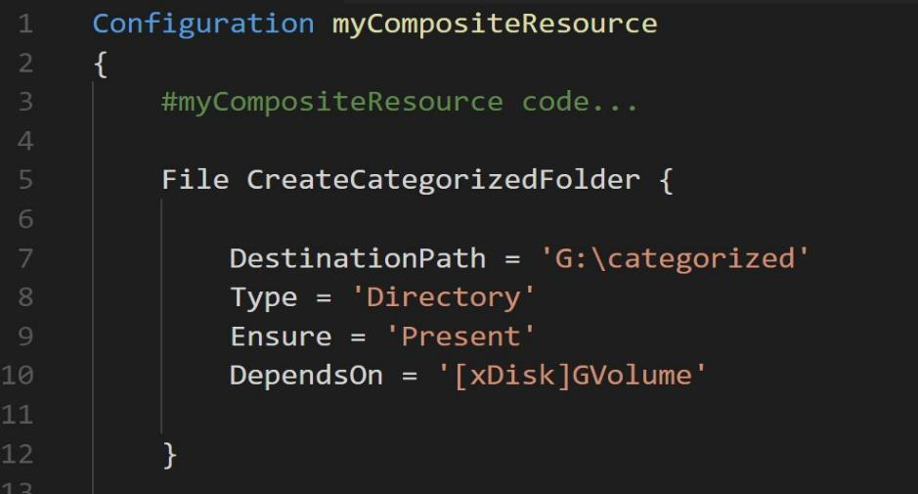
Composite DSC - Layout
<ParentFolder> → Add this folder to the PowerShell path for the publish tool to work
MyCompositeResourcePackage (Folder)
1.0 (Folder – version number)
MyCompositeResourcePackage.psd1 (<-manifest file. Auto generated by New-ModuleManifest tool)
DSCResources (Folder)
myCompositeResource (Folder)
myCompositeResource.psd1 (<-manifest file. Auto generated by New-ModuleManifest tool)
myCompositeResource.schema.psm1 (<- code file where your common code goes!)
The name of the PSD1 & PSM1 must be the same as the name of the Configuration block in your PSM1 file! ☺
No “node” block in the psm1 file!

Slide 89
Packaging Your Composite Resource
Publish-AzureRMVMDscConfiguration needs to know about your new Composite Resource
Change the path of Powershell to include your new local folder:
$env:PSModulePath = $env:PSModulePath + “;” + “myDscs;” (myDscs is the root containing your Composite Resource).
Now run your Publish command

Slide 90
Challenge #8 Composite DSC
Break out the DSC that creates the folders into a composite DSC
Leave the DSC that creates the SMB shares.
Don’t forget your DependsOn section in the DSC
Find the directory structure
Create your Manifests: New-ModuleManifest –Path xxx
Package manually

Slide 91
Bonus DSC Challenges

Slide 92
Bonus DSC Challenge #1 Windows Web Server
Add a DSC extension to the ARM Template
Add a DSC script to enable IIS and turn off the default website
Go through the motions of packaging the DSC script up and deploying via blob storage

Slide 93
Bonus DSC Challenge #2 More complex DSC
Extend the DSC by creating a new website
Pull a ZIP file from blob storage
Unpack the zip file into a new site directory

Slide 94
Bonus DSC Challenge #3 Composite DSC
Break out the DSC that enables IIS and disables the default website into a composite DSC
Leave the custom web site things in the main DSC script

Slide 95
Hands-on: Azure Automation

Slide 96
Azure Automation (basic steps)
Use the Portal
Create an Azure Automation account (think of it as a service account)
Associate a Runbook to the account (browse the gallery)
Create a schedule
Associate the schedule to a Runbook
Automation Accounts are used to automate the application of a DSC as well.

Slide 97
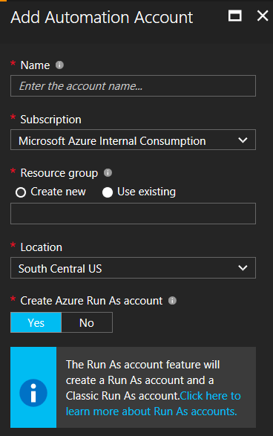
Create an Automation Account
New -> Management + Monitoring -> Automation
Give it a name
Select the subscription
Add it to a resource group
Select location
Create Azure Run As Account (yes or no)
*Run As account which creates a new service principal in Azure Active Directory, a certificate, and assigns the Contributor role-based access control (RBAC), which will be used to manage Resource Manager resources using runbooks.
Details: https://docs.microsoft.com/en-us/azure/automation/automation-sec-configure-azure-runas-account
Read above and you’ll see, it’s not really worth doing this in Powershell.

Slide 98
DSC in Azure Automation
Azure Automation Accounts provide DSC automation out of the box
No special runbooks needed
First set up the account with prerequisites:
Credentials & Certificates
Imported DSC “Resource” Modules
Publish a DSC Configuration
Register a DSC Node (ie: a VM) and associate it to a configuration.

Slide 99
Orchestration (with Jenkins)

Slide 100
Challenge #9 Service Principal
Create an Azure service principal via Azure CLI or PowerShell

Slide 101
Azure Dev Test Labs

Slide 102



Challenges of running dev-test on premises
Your datacenter
IT admin
VMs in dev-test environment
Developers
Provision VMs
Request VMs
65%
of developers say it is too complicated and time-consuming to get development and test resources
Your challenges
Compromised agility
Limited hardware budget
Limited software licensing
Resource contention with VMs
Realistic scale tests often challenging
Procurement delays
10%
Average utilization of dedicated dev-test infrastructure
Source: Business Case for Test Environment Management Whitepaper, Cognizant

Slide 103
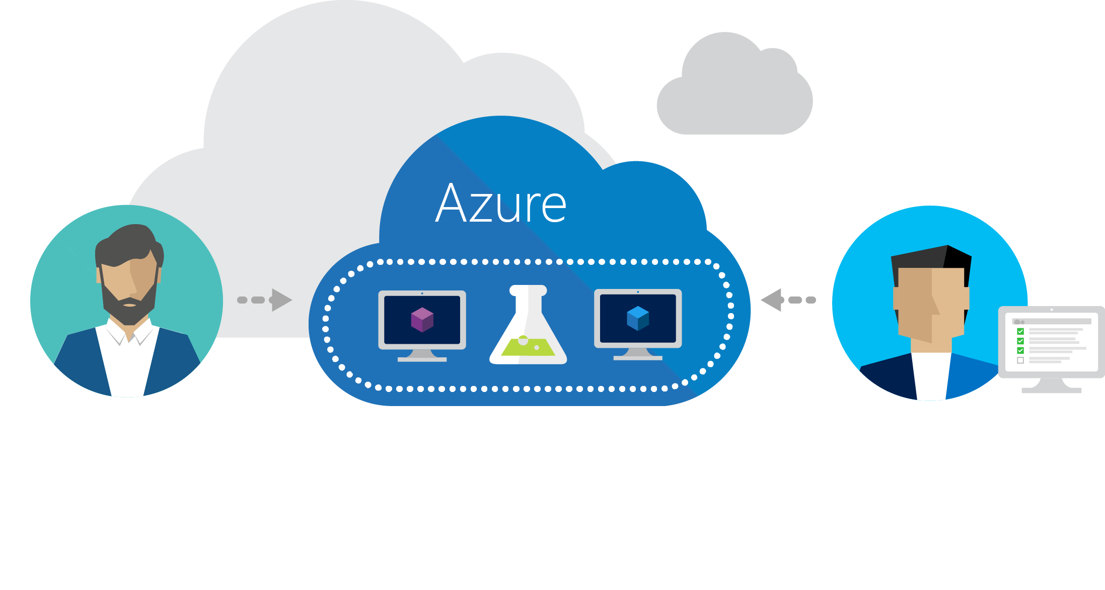
Azure DevTest Labs
Fast, easy, and lean dev-test environments in Azure.
Specifically for your team. On demand.

Slide 104
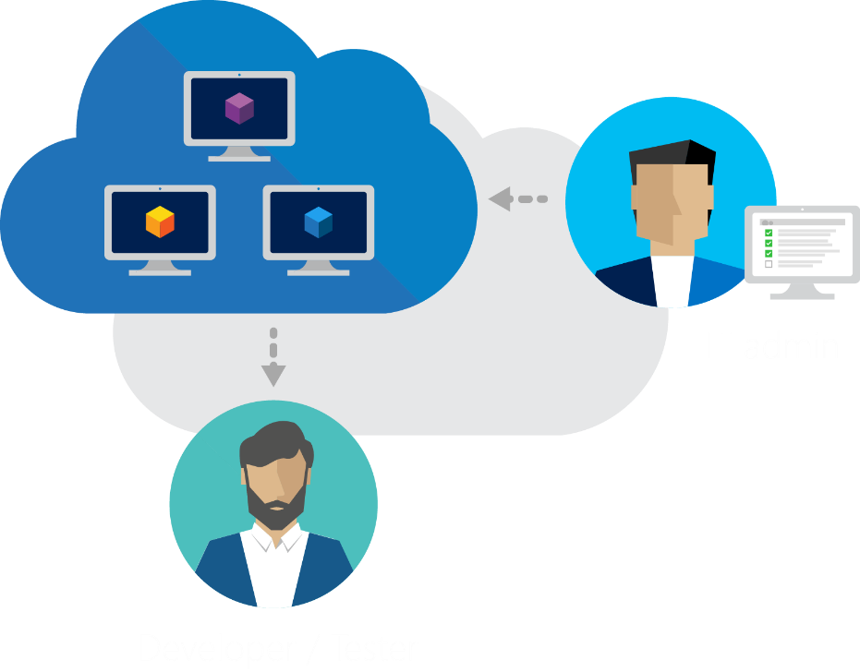
Worry-free self-service
Provision environments with allocated quotas and policies
Control costs
Track project spending
Notes:
Quotas Policies Templates Security Dashboards

Slide 105

Fast provisioning
Pre-provision environments
Claim an environment and start working immediately
Use containers

Slide 106

Create once, use everywhere, by everyone
Create templates once
Share templates within your team
Test environments easily

Slide 107
Walkthrough: Dev Test Labs

